Slide 1

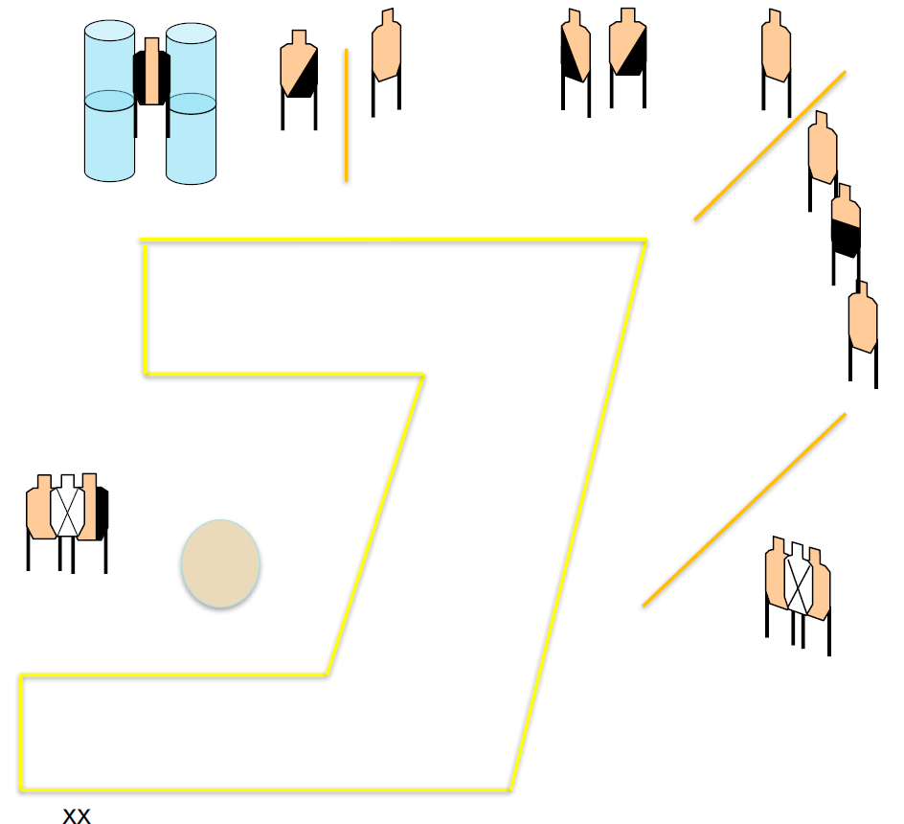
 | Renton Fish and Game Bay 5 Hit Me With Your Best Shot Course Designer: Chris Pukalo
START POSITION: Standing outside the shooting area, toes touching marks, wrists below belt, facing anywhere downrange. Gun loaded and holstered. PCC: Standing outside the shooting area, toes touching marks, facing anywhere downrange. Gun loaded, stock touching belt, muzzle pointed anywhere downrange.
STAGE PROCEDURE: At start signal, engage targets as they become visible from within the shooting area. |  | SCORING: Comstock, 26 rounds, 130 points TARGETS: 13 metric SCORED HITS: Best 2 per paper START-STOP: Audible - Last shot

